Slide 1

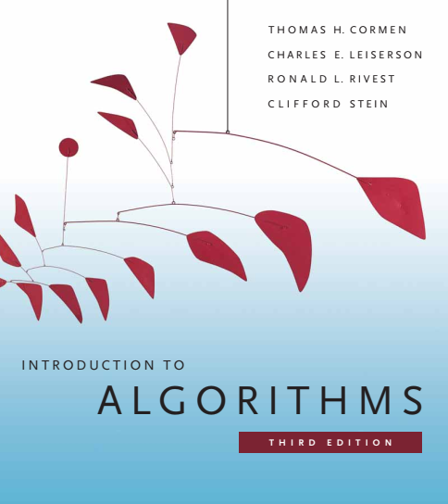
Design and Analysis of Algorithms
Dr. Sajid Iqbal
sajidiqbal.pk@gmail.com
Reference Book
Introduction to Algorithms 3rd Edition By Thomas H. Cormen et. al.
https://mitpress.mit.edu/books/introduction-algorithms-third-edition
COMEDXD

Slide 2
Basic Data Structures
Implementing pointers and objects

Slide 3
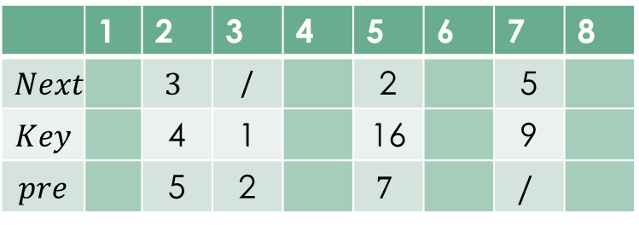
Introduction
C language provide the ways to implement pointers
Modern languages do not allow to implement pointers directly
Pointers allow to access the memory directly
it can be unsafe to change the memory contents of the area reserved for other programs.
How do we implement pointers and objects in languages that do not provide them?
A multiple-array representation of objects
Objects with same data type elements can be represented as an array
Let we consider a doubly linked list
prev | key | next
 | 1 | 2 | 3 | 4 | 5 | 6 | 7 | 8
$$Next$$ |  | $$3$$ | / |  | 2 |  | 5
$$Key$$ |  | 4 | 1 |  | 16 |  | 9
$$pre$$ |  | 5 | 2 |  | $$7$$ |  | $$/$$

Slide 4
A single-array representation of objects
The words in a computer memory are typically addressed by integers from 0 to M - 1.
An object occupies a contiguous set of locations in the computer memory.
A pointer is simply the address of the first memory location of the object
we can address other memory locations within the object by adding an offset to the pointer (indexing or addressing)
Same strategy can be adopted for languages that do not provide explicit pointers i.e. Python

Slide 5
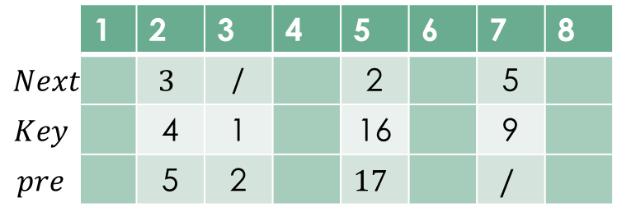
Single Array Representation of Objects
 | 1 | 2 | 3 | 4 | 5 | 6 | 7 | 8
$$Next$$ |  | $$3$$ | / |  | 2 |  | 5
$$Key$$ |  | 4 | 1 |  | 16 |  | 9
$$pre$$ |  | 5 | 2 |  | $$17$$ |  | $$/$$
1 | 2 | 3 | 4 | 5 | 6 | 7 | 8 | 9 | 10 | 11 | 12 | 13 | 14 | 15 | 16 | 17 | 18 | 19 | 20 | 21 | 22 | 23 | 24
 |  |  | 5 | 4 | 3 | 2 | 1 | / |  |  |  | 17 | 16 | 2 |  |  |  | / | 9 | 5
An object occupies a contiguous subarray A[j.. k]
Each attribute of the object corresponds to an offset in the range from 0 to k – j
The single-array representation is flexible in that it permits objects of different lengths to be stored in the same array

Slide 6
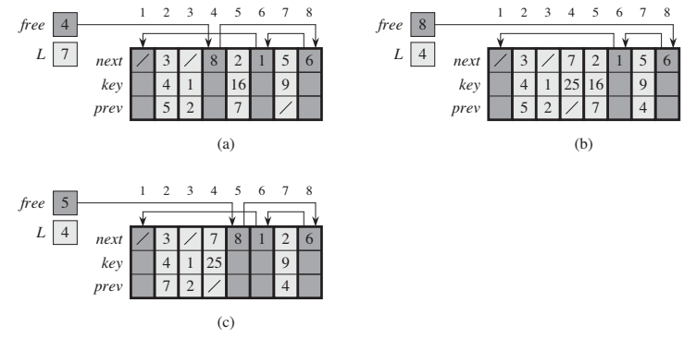

Allocating and freeing objects
For dynamic sets, memory is allocated for each node separately and using pointers, these nodes are linked
When a node is destroyed, allocated memory is recovered using garbage collection
Let there is an array that can keep $m$-objects and there are $n$-elements present where $m−n$ spaces are free
keep the free objects in a singly linked list, which we call the free list
Figure (a) shows the free list
The head of the free list is held in the global variable free
Note that each object in the representation is either in list $L$ or in the free list, but not in both

Slide 7
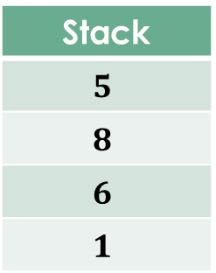
Allocating and freeing objects
The free list acts like a stack: the next object allocated is the last one freed.
We can use a list implementation of the stack operations PUSH and POP to implement the procedures for allocating and freeing objects, respectively.
We assume that the global variable free used to point the first element of the free list.
Stack
$$5$$
$$8$$
$$6$$
$$1$$
Stack Top

Slide 8
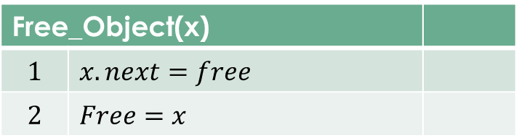
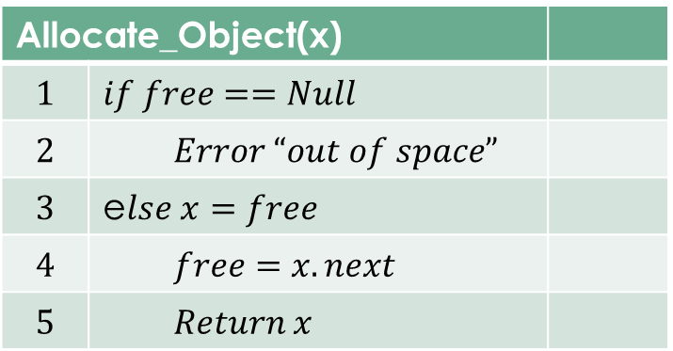
Allocating Object
The free list initially contains all n unallocated objects.
Error is produced if free list is exhausted
The two procedures run in O(1) time, which makes them quite practical
We can even service several linked lists with just a single free list.
Allocate_Object(x)
$$1$$ | $$if free==Null$$
$$2$$ | $$Error “out of space”$$
$$3$$ | e$lse x=free$
$$4$$ | $$free=x.next$$
$$5$$ | $$Return x$$
Free_Object(x)
$$1$$ | $$x.next=free$$
$$2$$ | $$Free=x$$

Slide 9

Thanks for watching
Dr. Sajid Iqbal
Assistant Professor
Department of Computer Science
Bahauddin Zakariya University, Multan
sajidiqbal.pk@gmail.com
Slides: https://github.com/sajjo79/Design_and_Analysis_of_Algorithms
YouTube Channel: COMEDXD
Allah Hafiz

